Slide 1

Back Order Prediction
Machine Learning Project
Bijayalaxmi kar

Slide 2
Objectives
A Backorder is an order which can’t be fulfilled at the given time due to lack of supply or the product is currently out of stock or not in inventory but can guarantee delivery of the goods or service requested by a certain date in the future because the production of goods or replenishment of inventory is underway. Unlike in the situation of Out-of-stock where the delivery date of the goods can’t be promised , in the Backorder scenario the customers are allowed to shop for the products and order. Simply put Backorder can be thought of as an order with a delayed delivery date.
The primary goal of all the companies is to increase the demand for the products they offer. Having a poor sales forecast system could one of the reasons for failing to predict the demand. Despite having a good sales forecasting system sometimes these situations are inevitable because of the factors which can’t be controlled or un predictable events.

Slide 3
Benefits:
Backorders are inevitable but through prediction of the items which may go on backorder planning can be optimized at different levels avoiding unexpected burden on production , logistics and transportation planning.
ERP systems produce a lot of data (mostly structured) and also would have a lot of historical data , if this data can be leveraged correctly a Predictive model can be developed to forecast the Backorders and plan accordingly.

Slide 4
Data Sharing Agreement:
Sample file name(Ex:backorder_02082021_010101)
Length of date stamp(8 digits)
Length of time stamp(6 Digits)
No of columns,column names
Columns Data type
Column Details

Slide 5
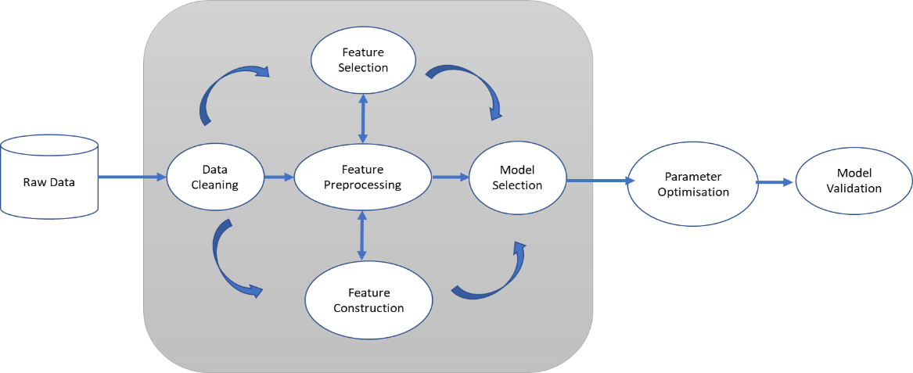
Application Architecture:

Slide 6
Data Validation & Data Transformation:
File Name Validation :File name validation as per the DSA. We have created regular expression pattern for validation with time stamp format. IF this file satisfy the pattern criteria it will go to valid_data_file folder or else it will go to bad_data file folder.
Name and no. of columns: It will check for number of columns and Name of the columns.If it will pass the validation criteria then it will goto valid_data_file or else bad_data_file.
Data types of column:The data types of column is given in schema file is valid or not.
Null values in Columns:If any columns in file contain null values or data ids missing then this file is going to bad_file_folder.

Slide 7
Data Insertion In Database:
Table Creation:we have to create a table in Database to insert valid data files ,if Table is already created then we need to insert new files into database.
Insertion:All valid files are inserted into the tables.

Slide 8
Model Training:
Data export from DB:
Data export from database table as csv format.
Exploratory Data Analysis & Data Pre-processing:
Missing value count
No of rows and columns(Shape)
categorical/Neumerical columns
Correlation heat map
Null value handling(impute null value)
Outlier detection and remove
Perform standard scalar for scaling down

Slide 9
Model Selection:
Evaluates clasification models using Logistic Regression,Random forest,Decision Tree through exhaustive grid search, using stratified 5-fold cross-validation, and Area Under Precision-Recall Curve (AUPRC) scorer.
compute metrics and generate graphs for model evaluation and importance analysis.
We view AUC values for each model and plot the ROC curves for the top random forest model and down sampled random forest model.
Finally, we fit the random forest model with optimal tuning parameters on the entire dataset. We then could use this model to predict whether parts will go on backorder.

Slide 10
Prediction:
The testing files are shared in batches and we perform the same validation operations, data transformation and data insertion on them.
The accumulated data from db is exported in csv format for prediction.
We perform data pre-processing techniques in it.

Slide 11
Q & A
Q1:Explain about the Project and your day to day task :
A:Product backorder may be the result of strong sales performance (e.g. the product is in such high demand that production cannot keep up with sales). However, backorders can upset consumers, lead to canceled orders and decreased customer loyalty. Companies want to avoid backorders, but also avoid overstocking every product (leading to higher inventory costs).
As a data scientist I am involving in each an every phase of the project. My responsibility consisted of gathering the dataset ,labelling the data for the model,training the model on the prepared dataset,deploying the traing model to the cloud,monitoring the deployed model for any issues. Mixed in are calls, stand ups and the attending
Scrum meeting.

Slide 12
Q & A
Q2:What is the source and size of data
A:The data for train is provided by client in batches.Size of the data usually in MB.
Q3:What was the team size
A:It is the size of 10 with manager ,solution archtech,Developers,Datascintist.
Q4:How were u creating and maintaining the log:
A:The Logs ar e used in Casandra. Logs are an essential part of troubleshooting application and infrastructure performance. Logs are not only to capture the state of our program but also to discover possible exceptions and errors.

Slide 13
Q & A
Q5:What techniques r you using for data preprocessing
A:Removing unwanted attributes.
Visualizing relation of independent variables with each other and with dependent variable.
Removing Outliers.
Cleaning data and imputing if null values are present.
Convering Categorical data to neumerical data.
Scaling the data.

Slide 14
Q & A
Q6:How were you maintain the failure cases?
A:If our model is not predicting correctly for data then that dataset goes to database . There will be a report triggered to the support team at the end of the day with all failure scenarios where they can inspect the failure. Once we have a sufficient number of cases we can label and include those data while retraining the model for better performance.
Q7:In which technology you are most comfortable?
A:I have worked in almost all the fields like machine learning Deep learning and NLP. But personally I prefer deep learning.
Q8:What Kind of challenges have u faced during the project?
A:The biggest challenge I face in project is in obtaining good dataset,cleaning it to be fit for model and then labeling prepared dataset.Labeling is a time consuming task and it takes lots of our.Then comes the task of finding the correct algorithm to be used for business case.

Slide 15
Q & A
Q9:What will be your expectations?
A:I expect to work on different projects to enhance my technical skill and learn new things simultaneously.
Q10:What is your future objective?
A:My future objective is to learn new things in AI field because it changes continuously and my aim is to parsue my carrer as a solution architect near future.

Slide 16
Q&A
Q11: How did you optimize your solution?
A:Model optimization depends on various factors
Train with better data or do data preprocessing in efficient way.
Increase the quantity of training data etc.
Try and use multithreaded approaches
Q12:At what frequency are u retraining and updating your model?
A:The model gets retrained every 30 days

Slide 17
Q&A
Q13:What is Overfitting, and How Can You Avoid It?
A:Overfitting is a situation that occurs when a model learns the training set too well, taking up random fluctuations in the training data as concepts. These impact the model’s ability to generalize and don’t apply to new data.
When a model is given the training data, it shows 100 percent accuracy—technically a slight loss. But, when we use the test data, there may be an error and low efficiency. This condition is known as overfitting.
There are multiple ways of avoiding overfitting, such as:
Regularization. It involves a cost term for the features involved with the objective function
Making a simple model. With lesser variables and parameters, the variance can be reduced
Cross-validation methods like k-folds can also be used
If some model parameters are likely to cause overfitting, techniques for regularization like LASSO can be used that penalize these parameters

Slide 18
Q&A
Q14:Explain the Confusion Matrix with Respect to Machine Learning Algorithms.
A:A confusion matrix (or error matrix) is a specific table that is used to measure the performance of an algorithm. It is mostly used in supervised learning; in unsupervised learning, it’s called the matching matrix.
The confusion matrix has two parameters:
Actual
Predicted
It also has identical sets of features in both of these dimensions.
Q15:How Will You Know Which Machine Learning Algorithm to Choose for Your Classification Problem?
While there is no fixed rule to choose an algorithm for a classification problem, you can follow these guidelines:
If accuracy is a concern, test different algorithms and cross-validate them
If the training dataset is small, use models that have low variance and high bias
If the training dataset is large, use models that have high variance and little bias

Slide 19
Q&A
Q16:What do you understand by selection bias?
It is a statistical error that causes a bias in the sampling portion of an experiment.
The error causes one sampling group to be selected more often than other groups included in the experiment.
Selection bias may produce an inaccurate conclusion if the selection bias is not identified.
Q17:Which is more important to you – model accuracy or model performance?
A:Well, you must know that model accuracy is only a subset of model performance. The accuracy of the model and performance of the model are directly proportional and hence better the performance of the model, more accurate are the predictions.
Q18. What is the difference between Gini Impurity and Entropy in a Decision Tree?
Gini Impurity and Entropy are the metrics used for deciding how to split a Decision Tree.
Gini measurement is the probability of a random sample being classified correctly if you randomly pick a label according to the distribution in the branch.
Entropy is a measurement to calculate the lack of information. You calculate the Information Gain (difference in entropies) by making a split. This measure helps to reduce the uncertainty about the output label.

